Slide 1
Late onset hypogonadism « the myth of the andropause »
Dr Ward Sam

Slide 2
Late Onset Hypogonadism
Definition
Facts
Epidemiology
Diagnosis
Treatment

Slide 3
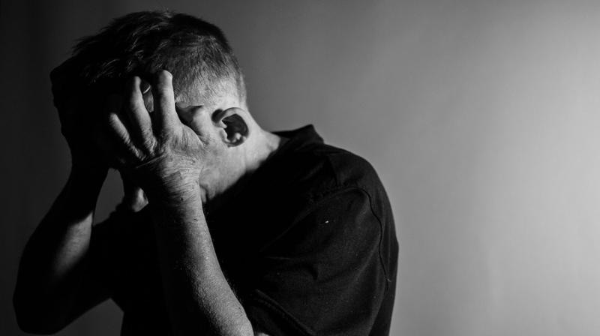
Definition
Low Testosterone
Age > 65
Symptoms:
Lethargy
Fatigue
Decreased sense of well-being
Depressive mood
Reduced physical and mental activity
Diminished libido (sexual desire)
Increased sweating
Reduced muscle and bone mass or even osteoporosis (Dexa?)
Erectile dysfunction
Mild anemia.

Slide 4
Late Onset Hypogonadism
Definition
Facts
Epidemiology
Diagnosis
Adam test
Treatment

Slide 5
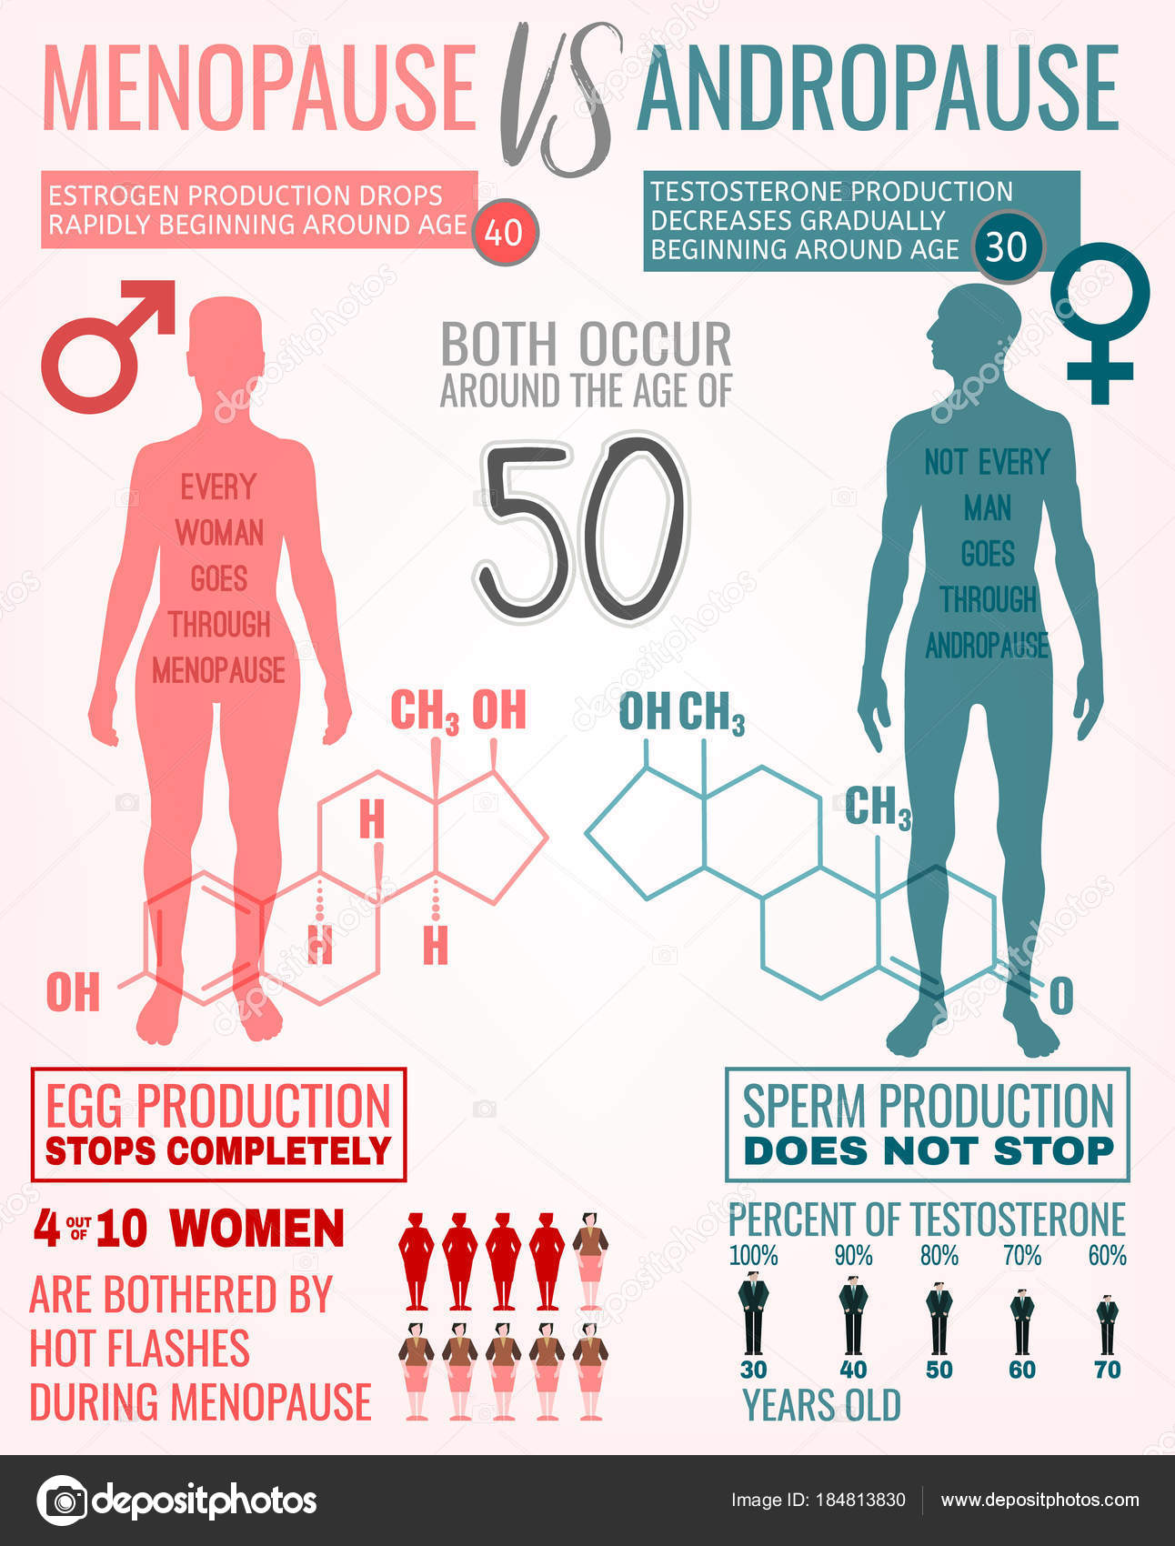

Slide 6
LOH is associated with substantially higher risks of all-cause and cardiovascular mortality, to which both the level of T and the presence of sexual symptoms contribute independently.
Detecting low T in men presenting with sexual symptoms offers an opportunity to identify a subgroup of aging men at particularly high risk of dying.

Slide 7
Belgie, anno 2019

Slide 8
Facts: from cone to pillar
Notes:
From pyramid to pillar

Slide 9
Late Onset Hypogonadism
Definition
Facts
Epidemiology
Diagnosis
Treatment

Slide 10
Risk of hypogonadism
Osteoporosis > fracture risk
Lean body mass lowering (muscle)
MMA linked: predictive of the development of metabolic syndrome
Cardiovascular burden in old populaten
Visceral fat
Cardiovascular comorbidities
Sexual symptoms
Low desire
ED

Slide 11
Epidiomology
3-6% of patients
2019 life expectancy doubled with 100 years ago
With ageing population, incidence will rise > 65 y old
WHO 2000: 500 milj
WHO 2050: 1,5 billion

Slide 12
Diagnosis
Clinical
Questionning
Clinical examination
Serum level
Total T, SHBG
Calculate free testosterone

Slide 13
Diagnosis

Slide 14
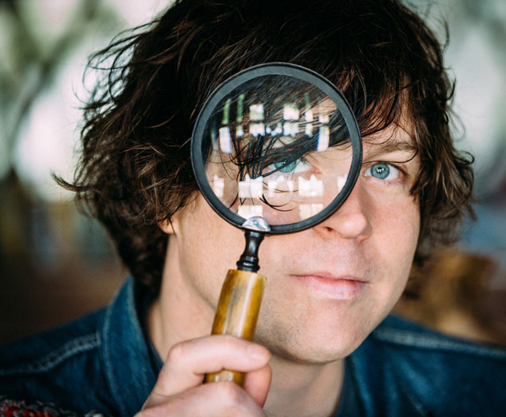
Diagnosis : use questionnaires

Slide 15
Differential Diagnosis

Slide 16
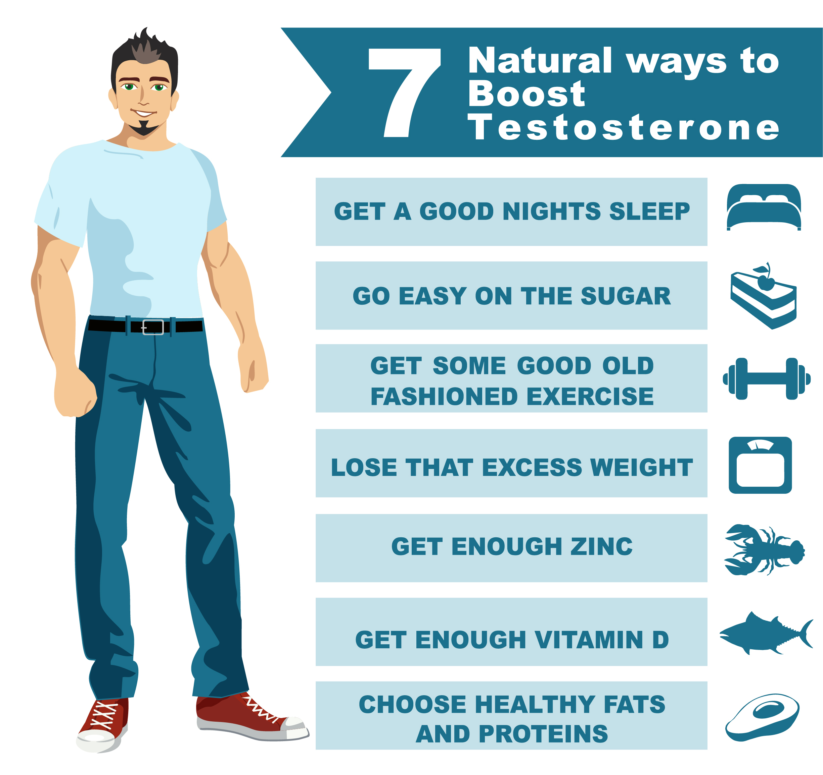
Treatment guidelines
PO doesn’t work
Lifestyle
Topical
Injection

Slide 17
Treatment Topical

Slide 18
Treatment Injection

Slide 19
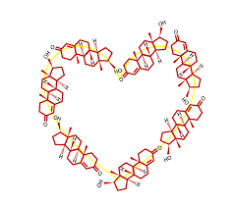

Slide 22
Take home messages
Incidence & prevalence of LOH will rise
LOH has a major impact on
Quality of life
Cardiovascular comorbidties
Skelettal related events
Diagnosis & treatment are easy
Treatment = benefit for patient & partner

Slide 23
sward@clstjean.be
+32 486 127 552
+32 2 221 98 63
@dr_wardsam

