Slide 1
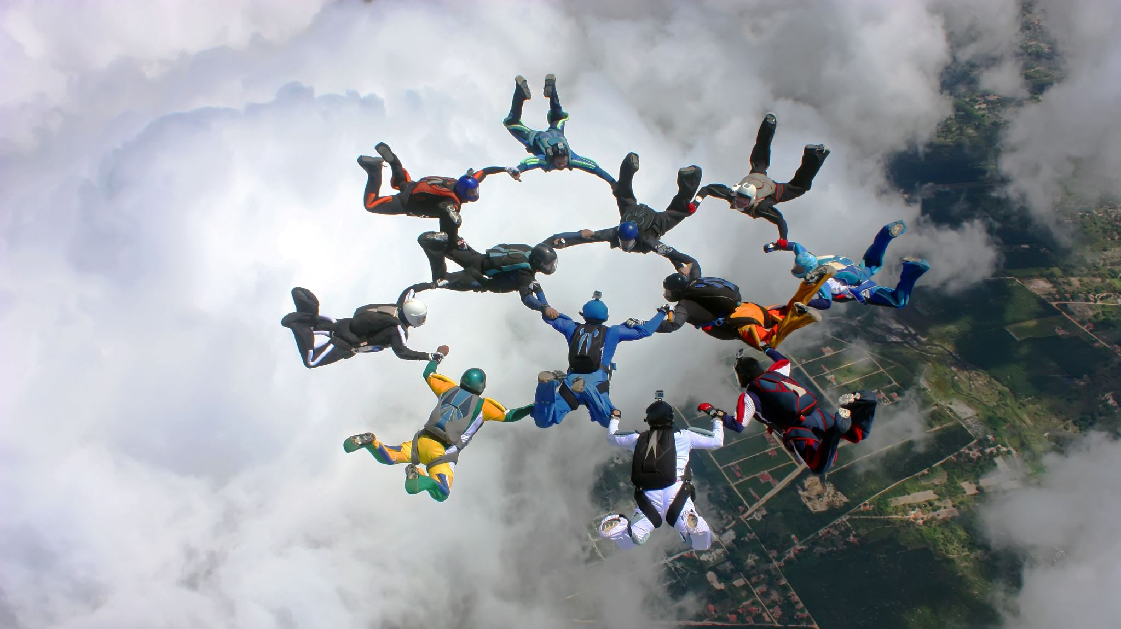
Live your life to the fullest
Dr. DELCARTE LESLIE, Dr. De Wil PETER & Dr. WARD SAM
UROLOGIE SAINT JEAN

Slide 2
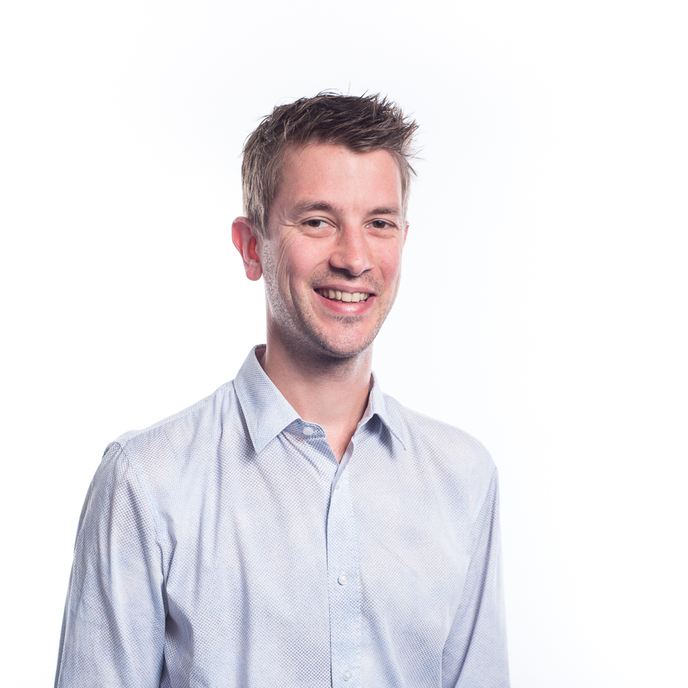
Dr De Wil Peter
Katholieke Universiteit Leuven
Oncologic Urology
Married, Brussels
Dad of 2
MCH Wezembeek
Cabinet Evere

Slide 3
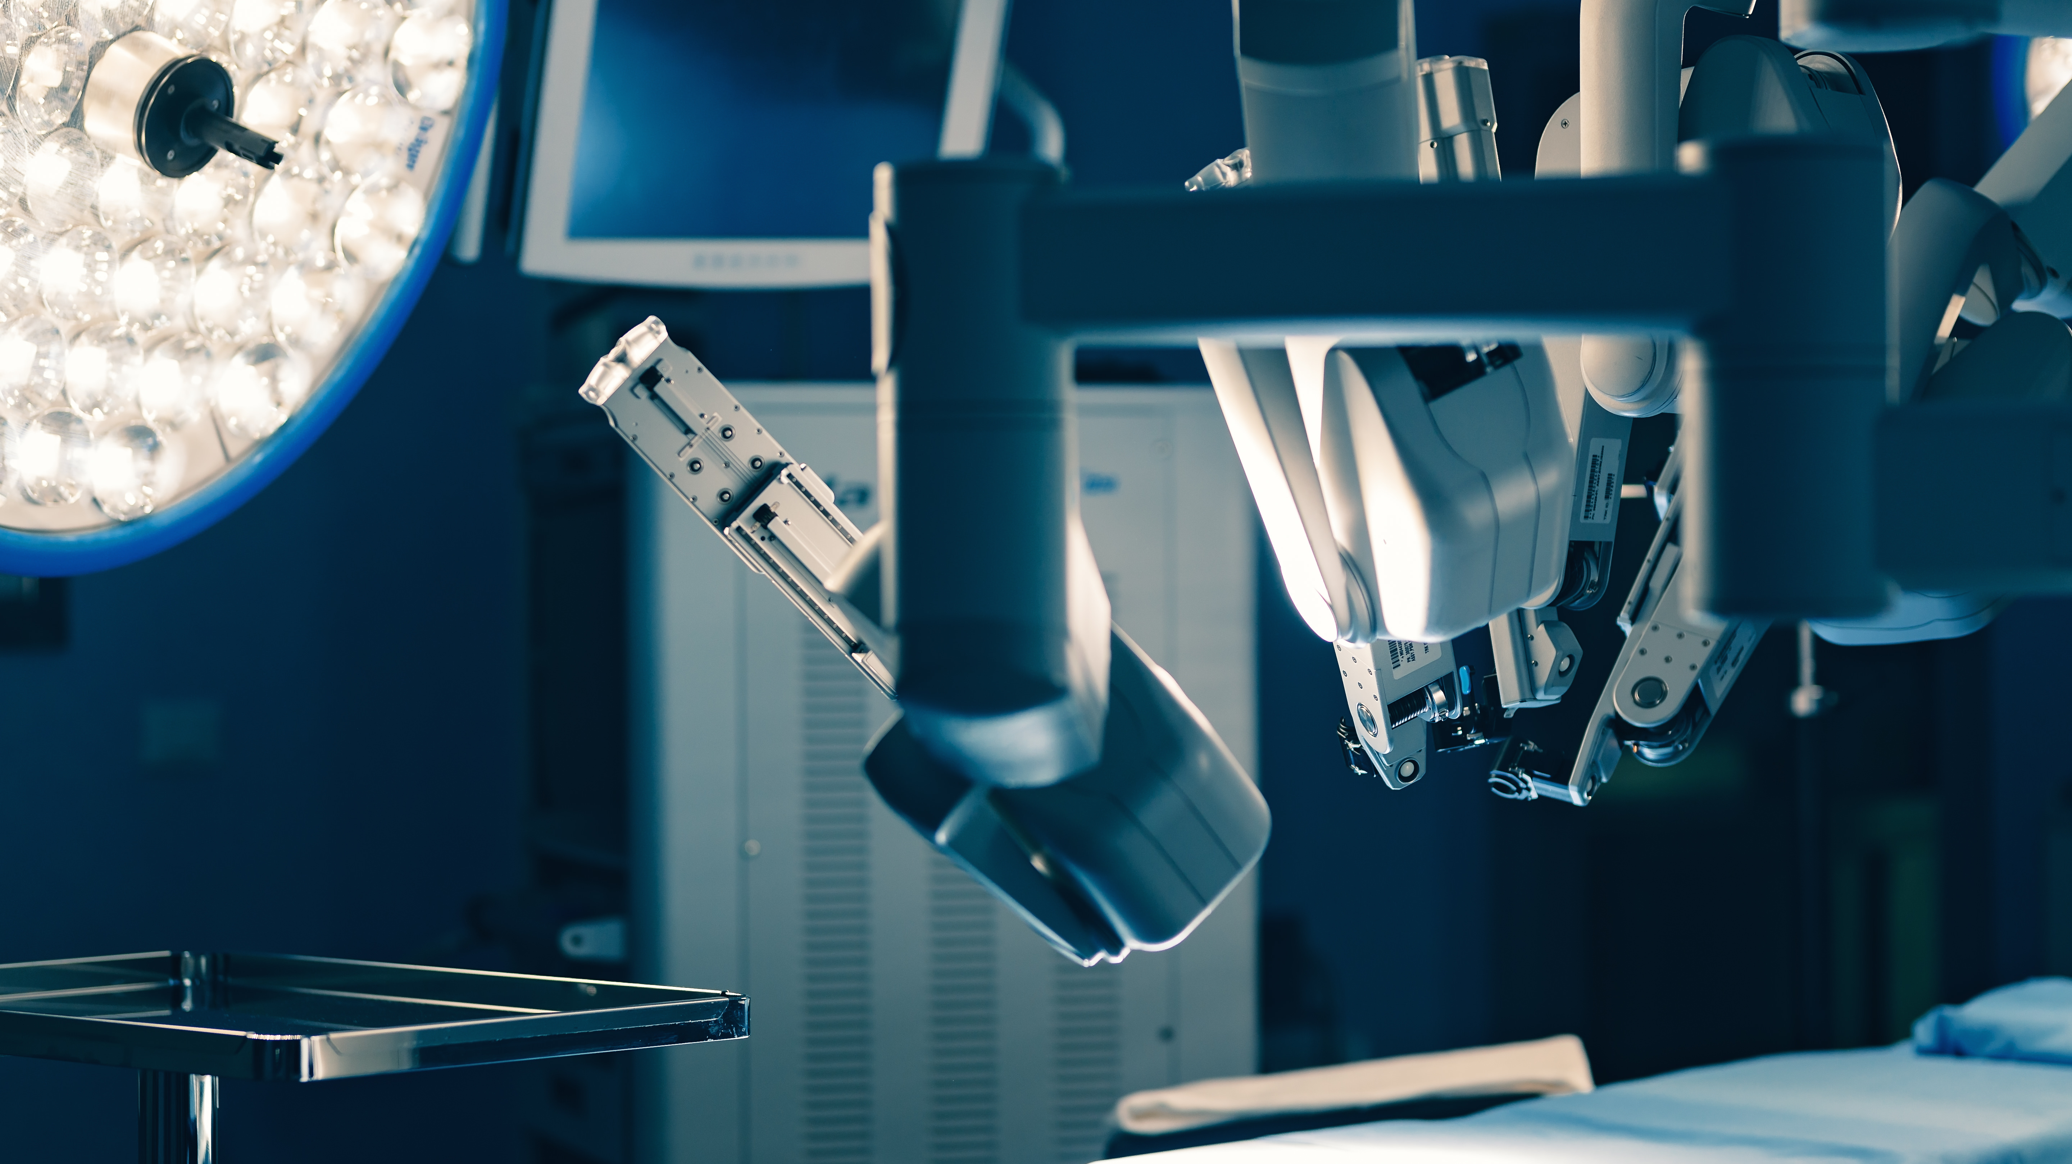
Oncologic surgeon
AZ JAN PORTAELS
Prostate surgery
Experience

Slide 4
Dr Delcarte Leslie
Université Catholique de Louvain
Functional Urology
Married, Brussels
Soon mom

Slide 5
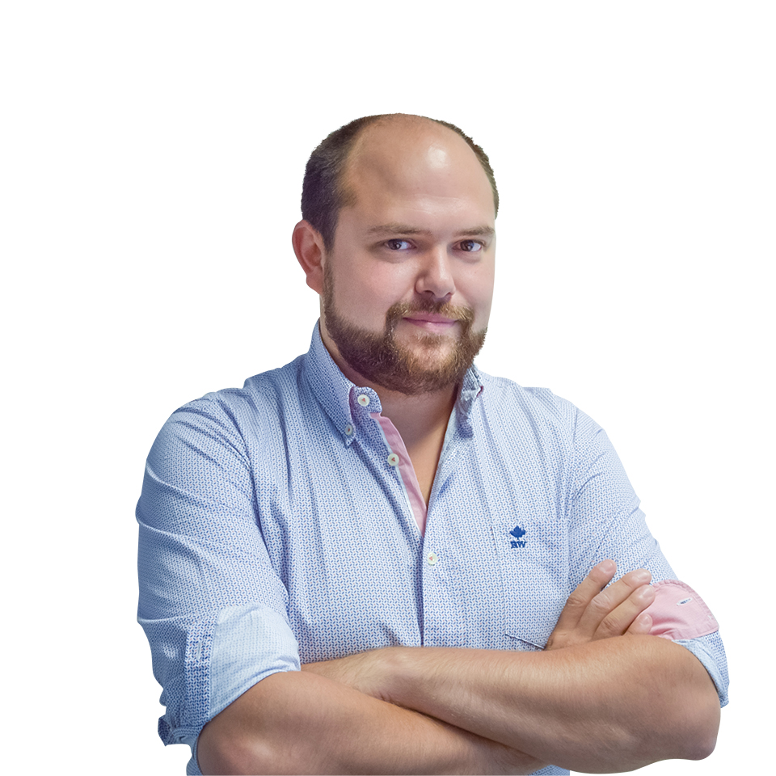
Dr WARD Sam
Clinique Saint Jean Urologue - Andrologue
Coordinateur du departement de chirurgie
Comité ethique
Comité quartier opératoire
Not married
Cabinet à Medicis
Clinique Valida

Slide 7
Definition of health
Health is a state of complete physical, mental and social well-being and not merely the absence of disease or infirmity.
International Health Conference held in New York from 19 June to 22 July 1946, signed on 22 July 1946 by the representatives of 61 States

Slide 8
Promote health & sexual health

Slide 9
Sexual health

Slide 10
Sexual health
Mental health
Body health

Slide 12
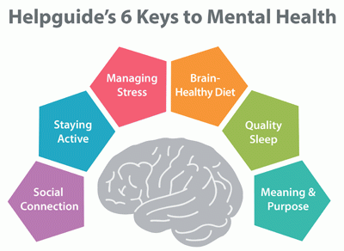
Male sexual health
Mental health

Slide 13
Male sexual health
Body health

Slide 14
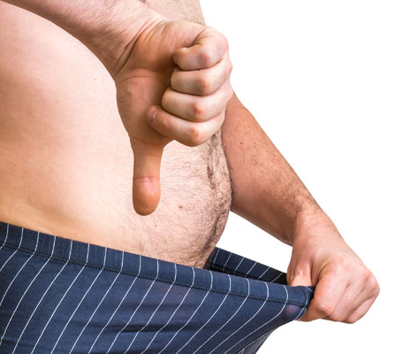
Keep erections
1. Mental health
2. Body health
3. Medication
4. Age
5. Past Medical History

Slide 15
Promote sexual health

Slide 16
Treatments
Lifestyle changes
Pills
Ring & Pump
Injection
Li-ESWT
Surgery

Slide 17
Lifestyle changes

Slide 18
Pills
Take easy
No side effects
Satisfactory
Price

Slide 20
Alprostadil gel

Slide 21
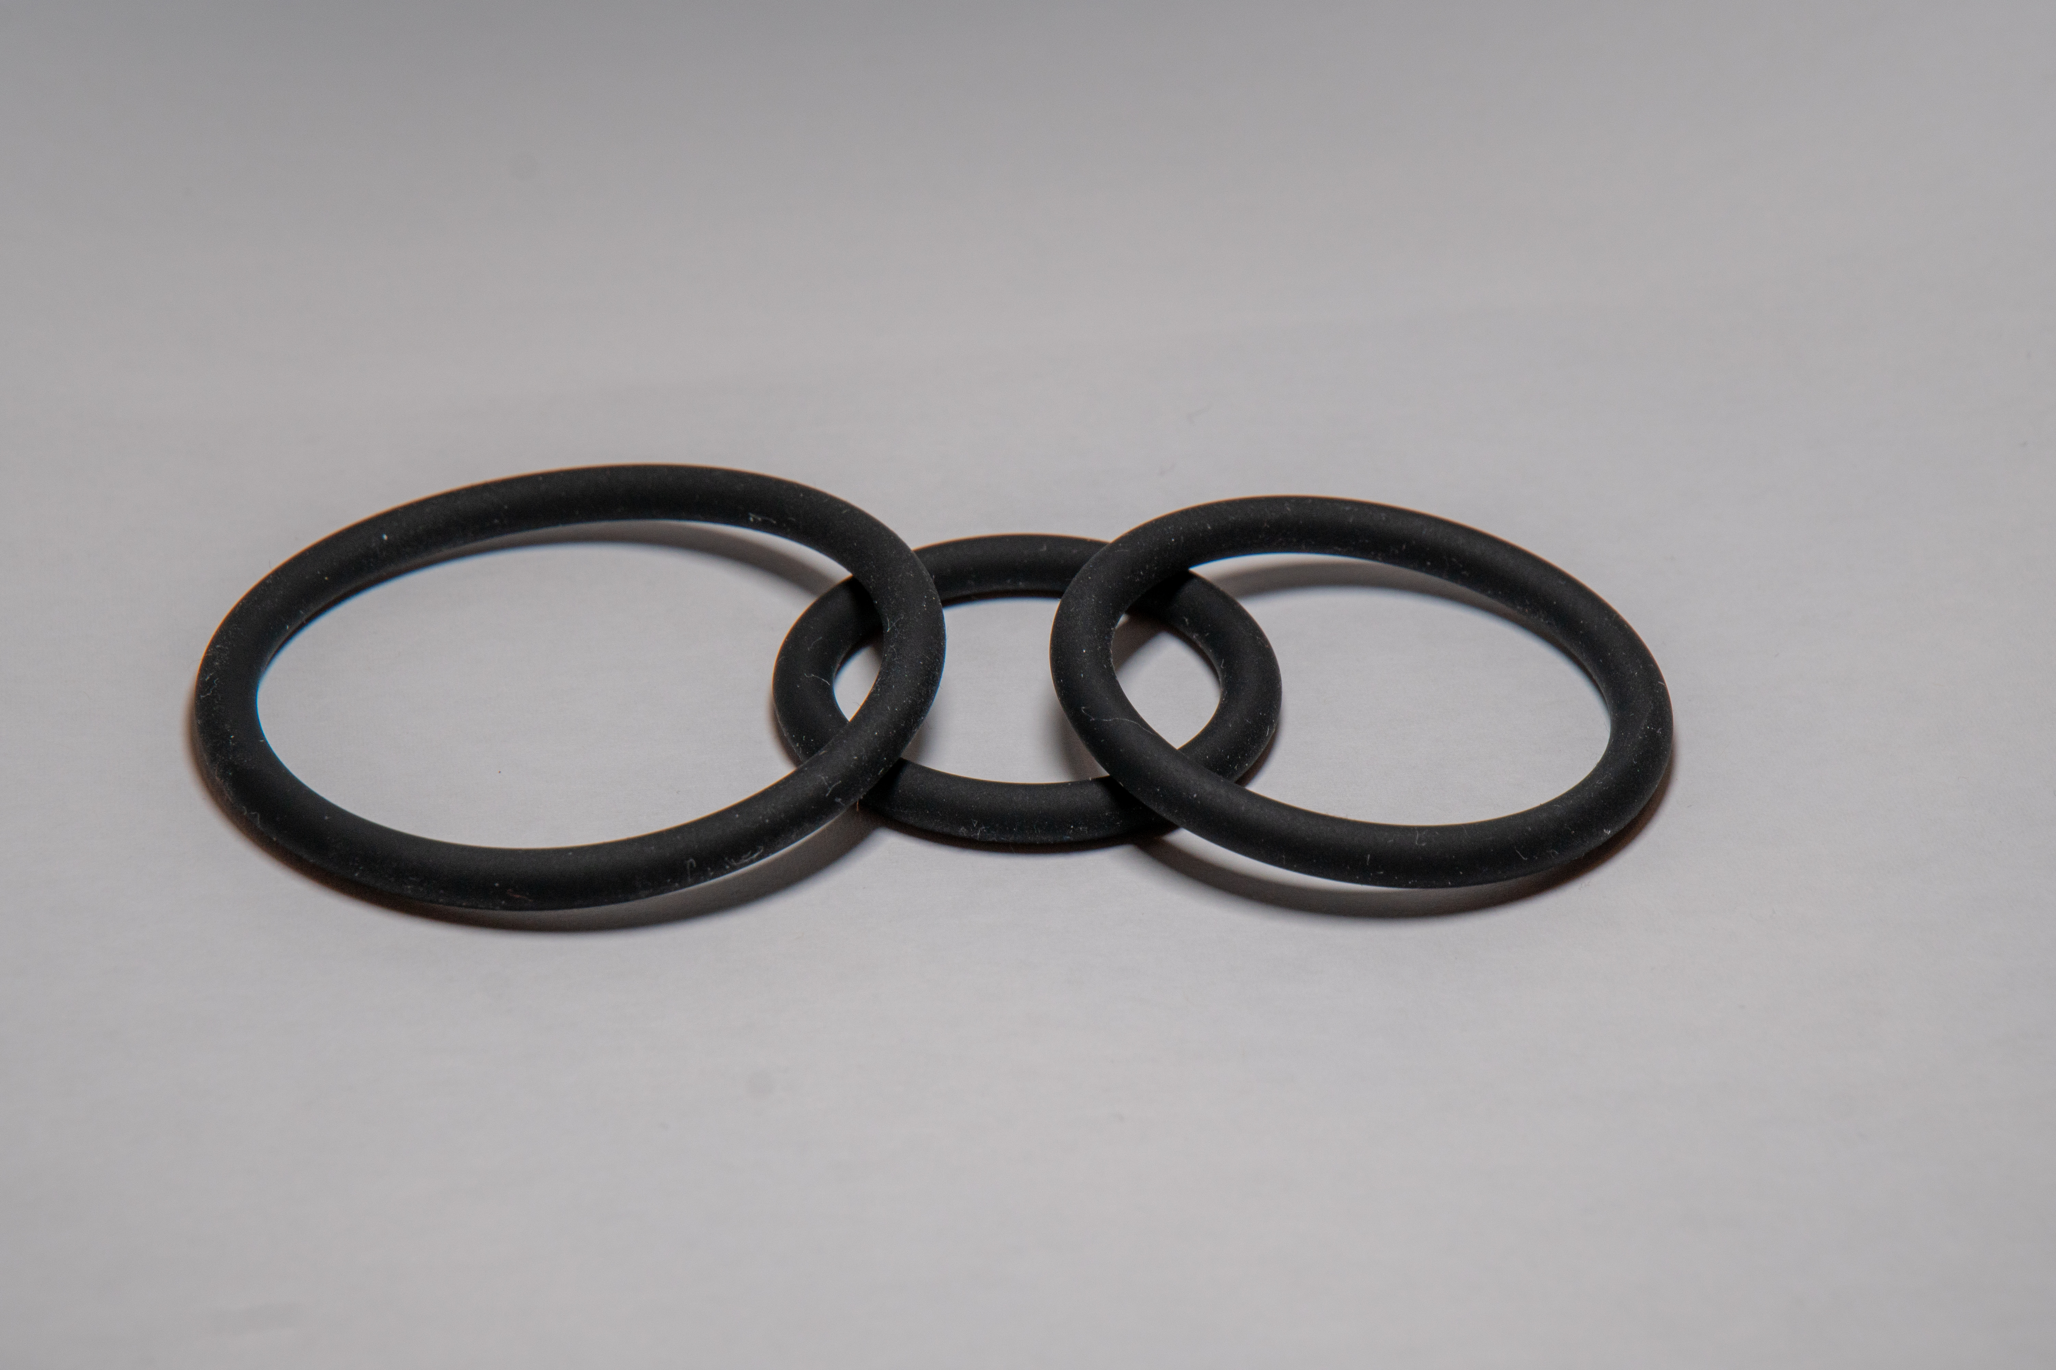
Ring & Pump

Slide 22
Injections

Slide 23
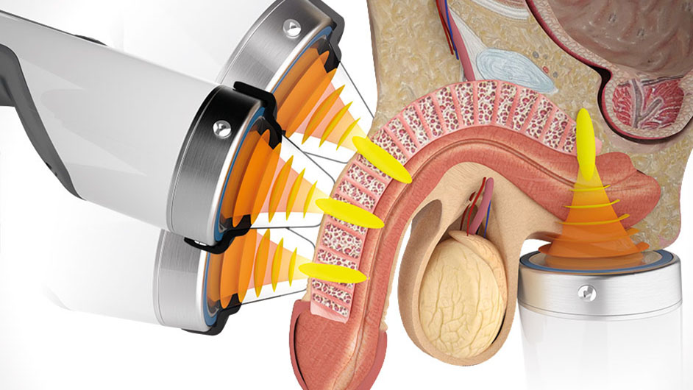
Li-ESWT : Shockwave
2 sessions a week
12 sessions in total
Not for everybody
€ 50/ session

Slide 24
Penile implants

Slide 26
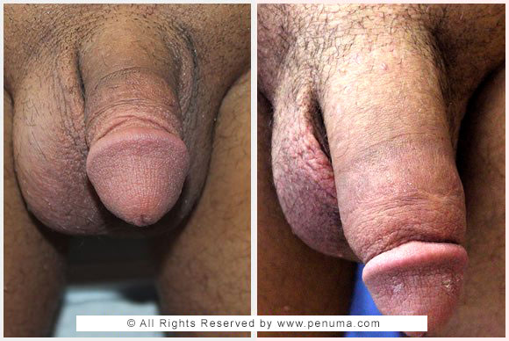
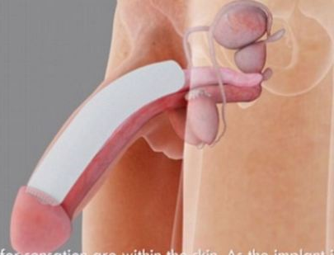
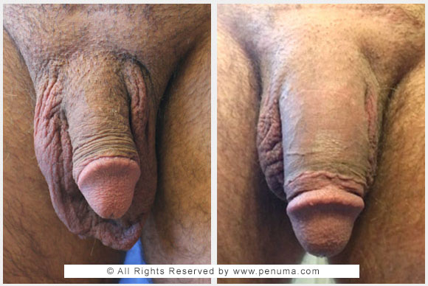
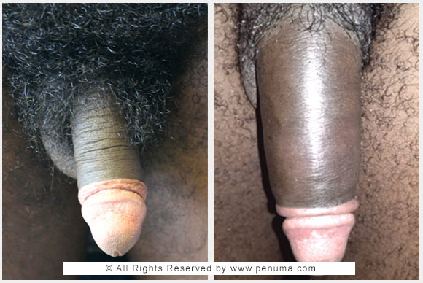
Long, Longer, Longest

