Slide 1
LATE ONSET HYPOGONADISME “the myth of andropause”
Dr WARD SAM
uro-androloog

Slide 2
Dr WARD Sam
Formation en NL
FR, ENG, DE
Clinique Saint Jean 8/10
Urologue - Andrologue
Coordinateur du departement de chirurgie
Comité ethique
Comité quartier opératoire
Cabinet à Medicis 1/10
Revalidation 0,5/10

Slide 4
YOSEMA Young Sexual Medecine Academicians
Notes:
Include logo yosema

Slide 6
Late Onset Hypogonadism
Definition
Facts
Epidemiology
Diagnosis
Adam test
Treatment

Slide 7
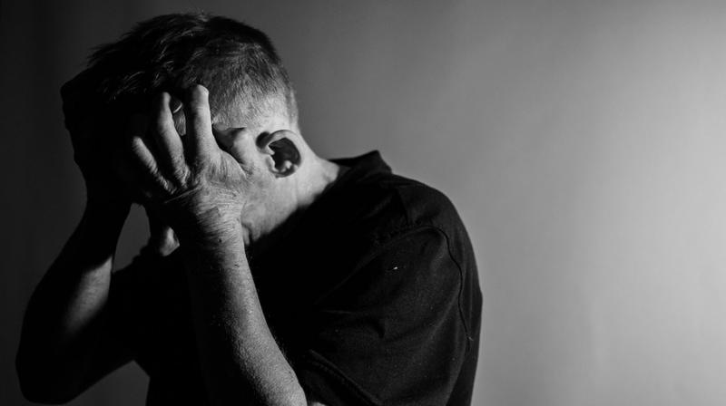
Definition
Low Testosterone
Symptoms:
Lethargy
Fatigue
Decreased sense of well-being
Depressive mood
Reduced physical and mental activity
Diminished libido (sexual desire)
Increased sweating
Reduced muscle and bone mass or even osteoporosis (Dexa?)
Erectile dysfunction
Mild anemia.

Slide 8
Late Onset Hypogonadism
Definition
Facts
Epidemiology
Diagnosis
Adam test
Treatment

Slide 9
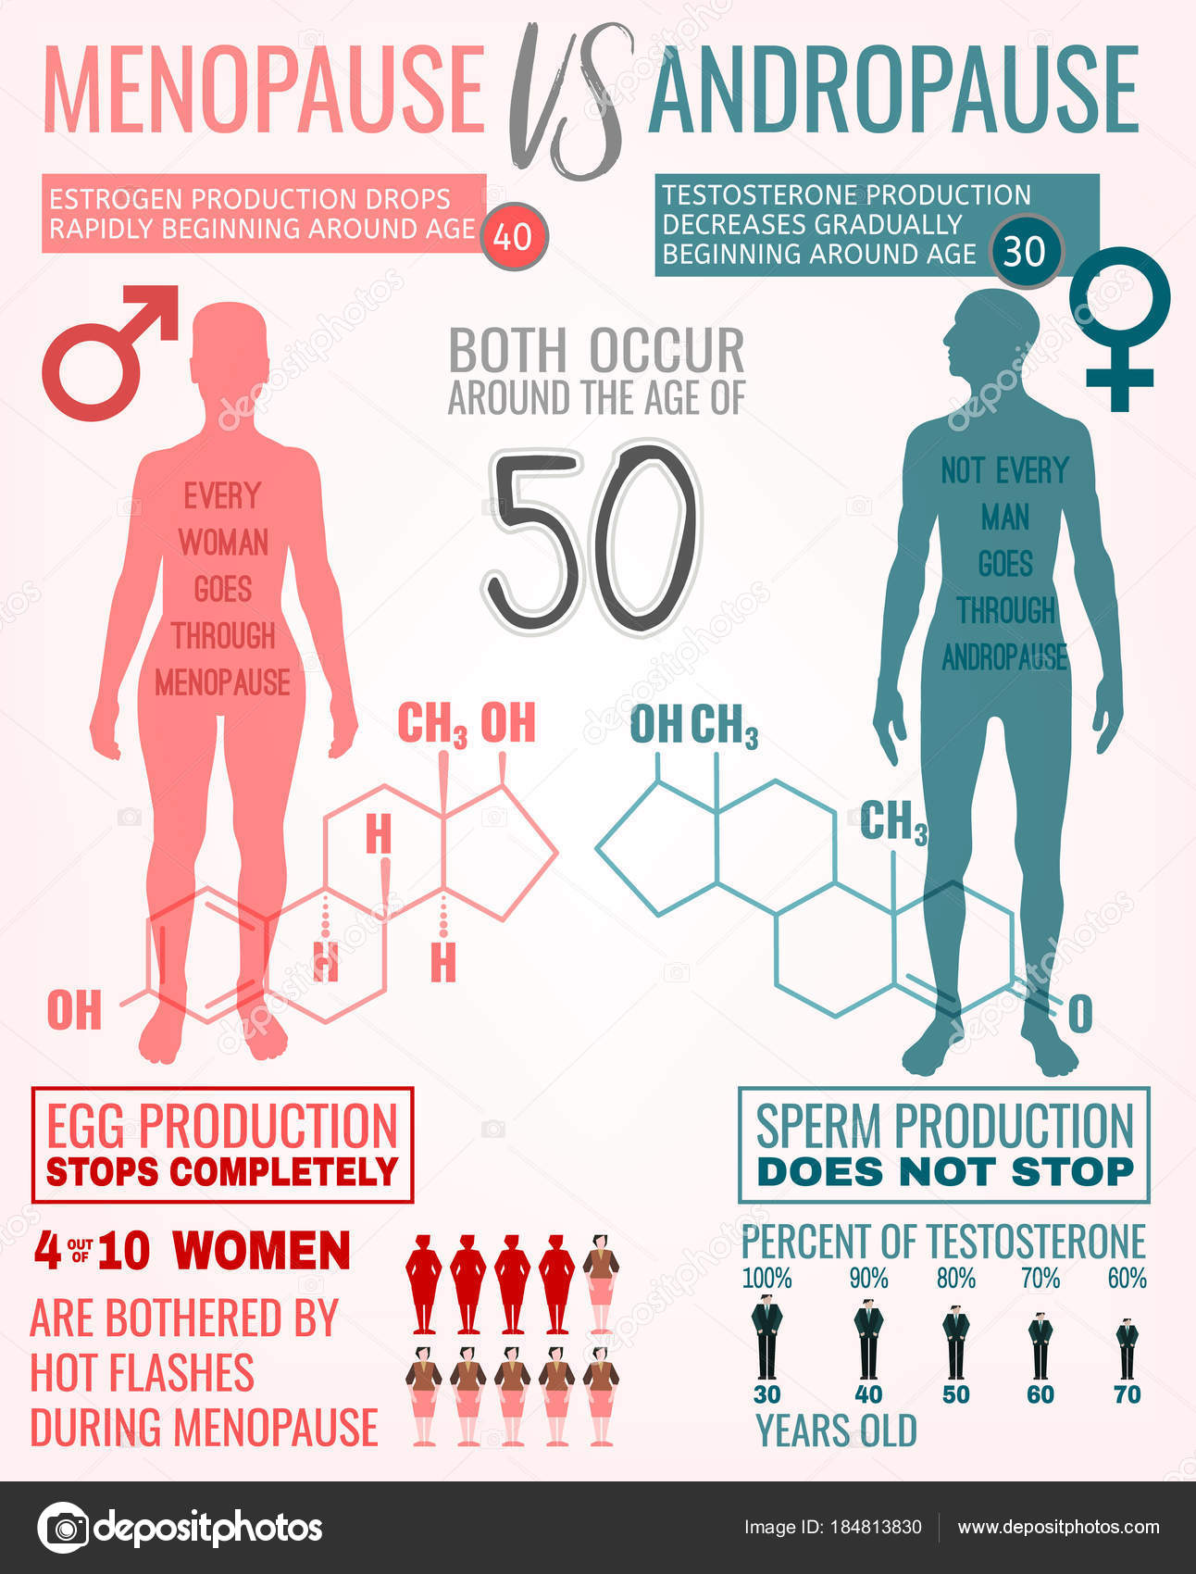

Slide 10
LOH is associated with substantially higher risks of all-cause and cardiovascular mortality, to which both the level of T and the presence of sexual symptoms contribute independently.
Detecting low T in men presenting with sexual symptoms offers an opportunity to identify a subgroup of aging men at particularly high risk of dying.

Slide 11
Belgie, anno 2019

Slide 12
Facts: from cone to pillar
Notes:
From pyramid to pillar

Slide 13
Late Onset Hypogonadism
Definition
Facts
Epidemiology
Diagnosis
Treatment

Slide 14
Risk of hypogonadism
Osteoporosis
Lean body mass lowering (muscle)
MMA linked: predictive of the development of metabolic syndrome
Cardiovascular burden in old populaten
Visceral fat
Sexual symptoms

Slide 15
Epidiomology
3-6% of patients
2019 life expectancy doubled with 100 years ago
With ageing population, incidence will rise > 65 y old
WHO 2000: 500 milj
WHO 2050: 1,5 billion

Slide 16
Diagnosis
Clinical
Questionning
Clinical examination
Serum level
Total T, SHBG
Calculate free testosterone

Slide 17
Diagnosis

Slide 18
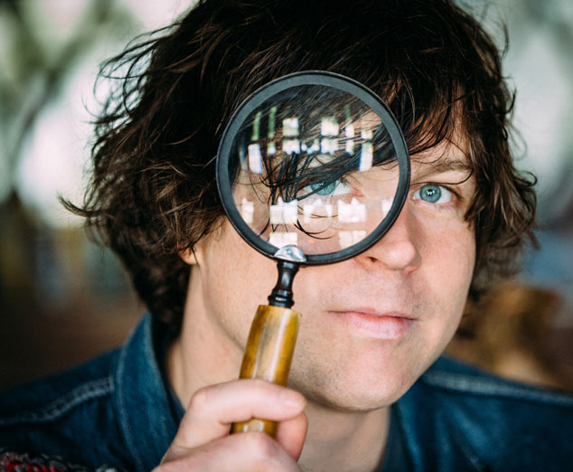
Diagnosis : use questionnaires

Slide 19
Differential Diagnosis

Slide 20
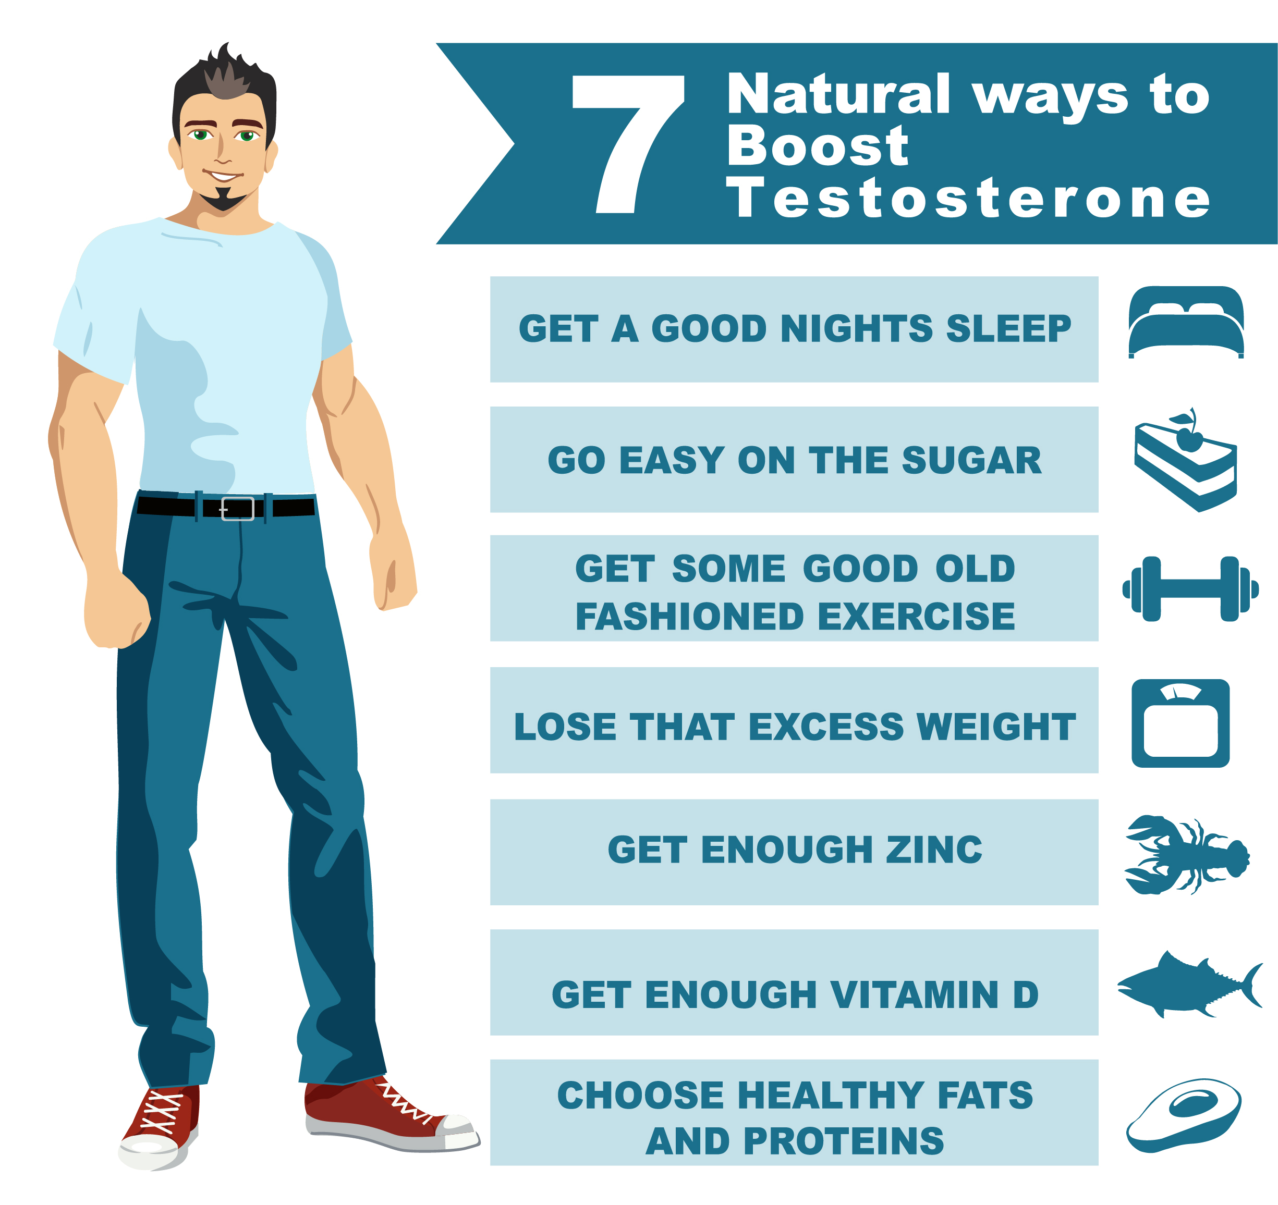
Treatment guidelines
PO doesn’t work
Lifestyle
Topical
Injection

Slide 21
Treatment Topical

Slide 22
Treatment Injection

Slide 24
sward@clstjean.be
+32 486 127 552
+32 2 221 98 63
@dr_wardsam

